Slide 1
SOCCER PLAYER ANALYSIS
Data Analysts: Alexandr Gorbulin, Rocky Owens, and Francis Shobo
February 8, 2023

Slide 2
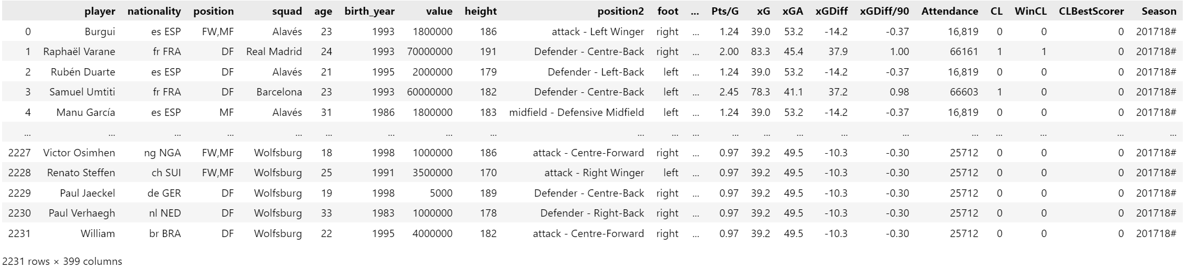
Scope & Purpose
Using a Kaggle.com merged data set from trasnfermarkt.de and fbref.com, soccer players from the top five
European leagues are analyzed using statistics to determine the relationship to player value.
The purpose of this soccer analysis is to reveal the statistics that make a player or soccer club more valuable than the others.

Slide 3
Questions
1. Which nationality has the most valuable players?
2. Which league has the most valuable players?
3. What is foot preference in relation to goals scored?
4. Which player plays the most minutes and receives the most red cards?
5. At what age is a soccer player at their highest value?
6. Which squad is the most valuable?
7. How does the league in which the player plays affect their value, goals scored, and minutes played?
8. How does the number of tackles and tackles won relate to the player's position?

Slide 4
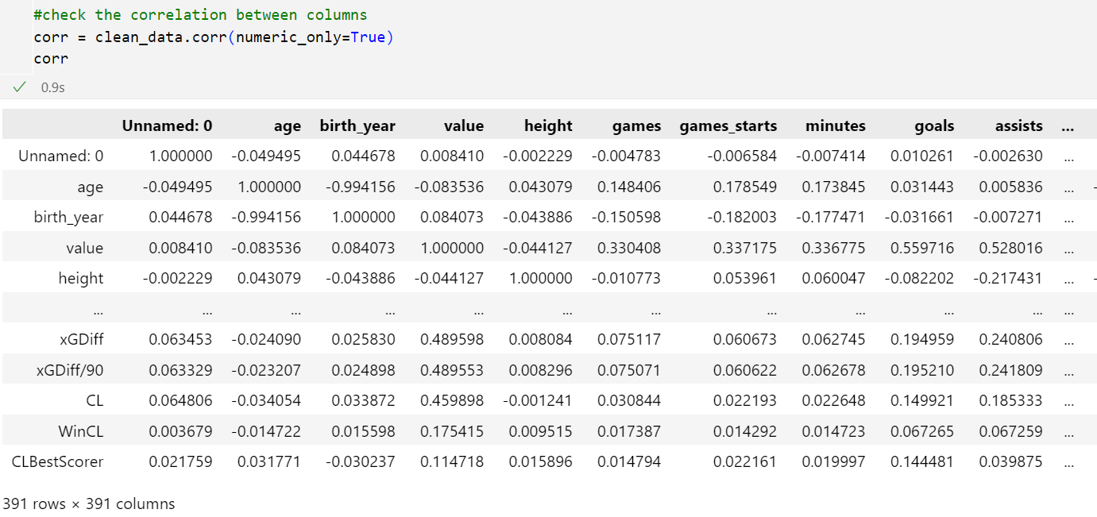
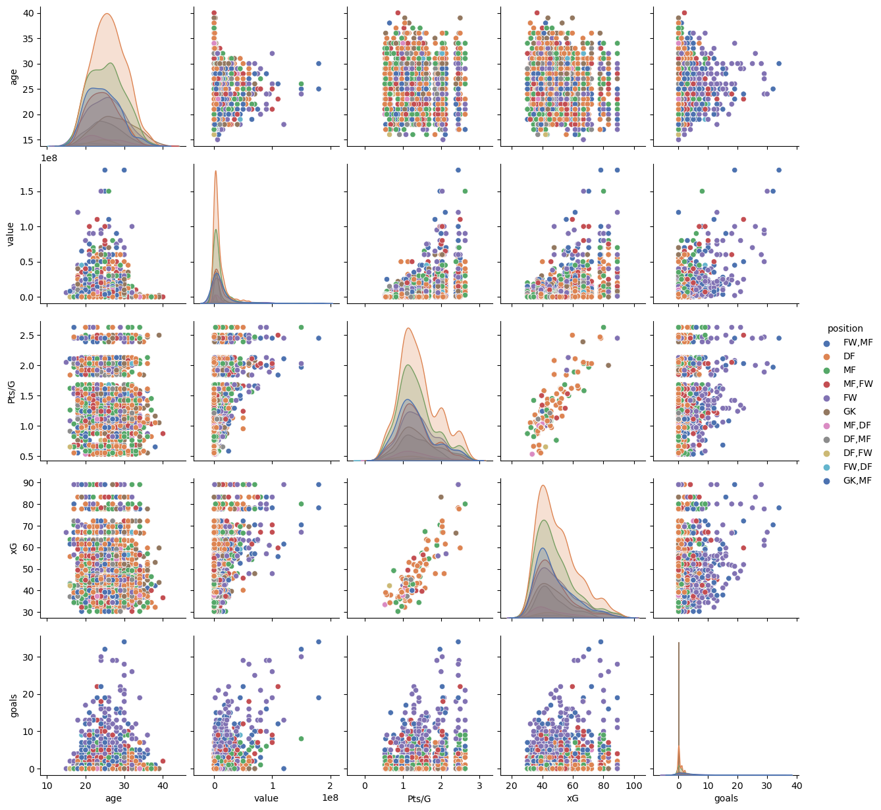
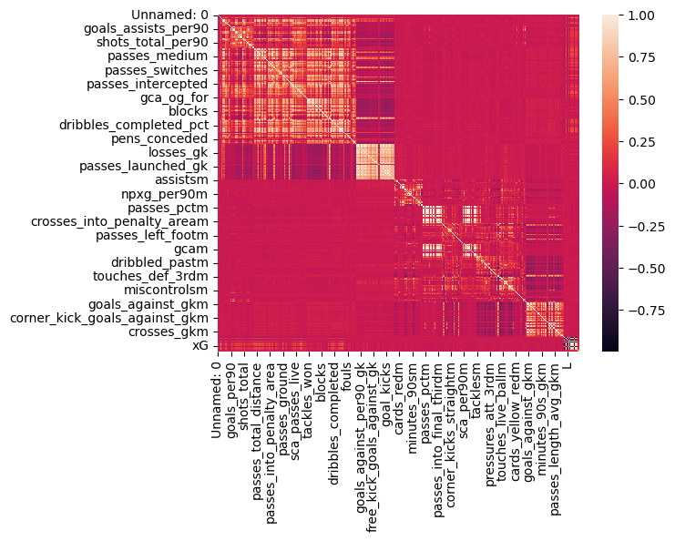
Seaborn Pair Plot – What data to use?
Correlation heatmap & Pairplot created to check for dependencies of the relationship between chosen variables.
Notes:
Pair plot created to check for dependencies of the relationship between chosen variables.

Slide 5
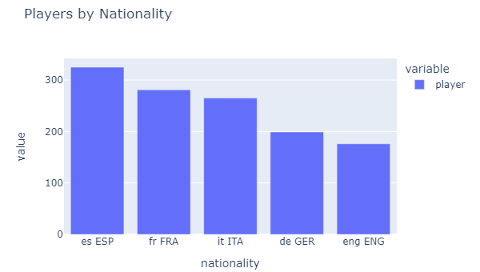
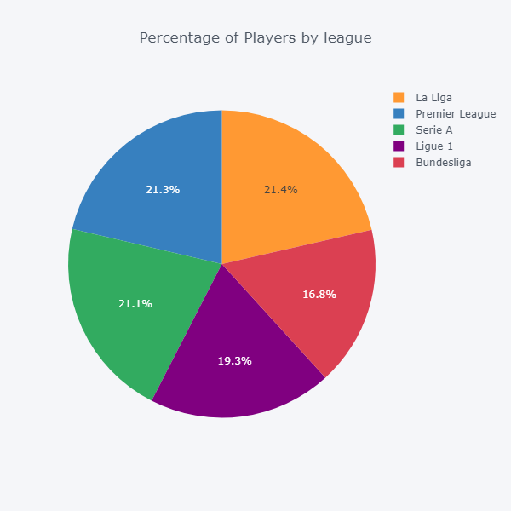
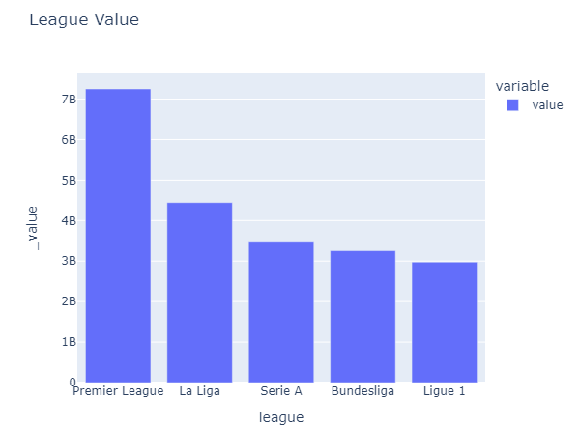
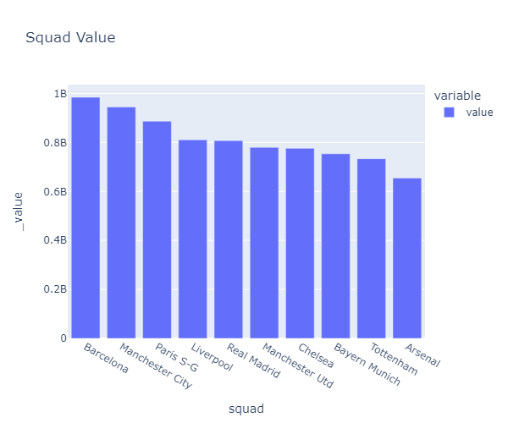
Main Players Statistics

Slide 6
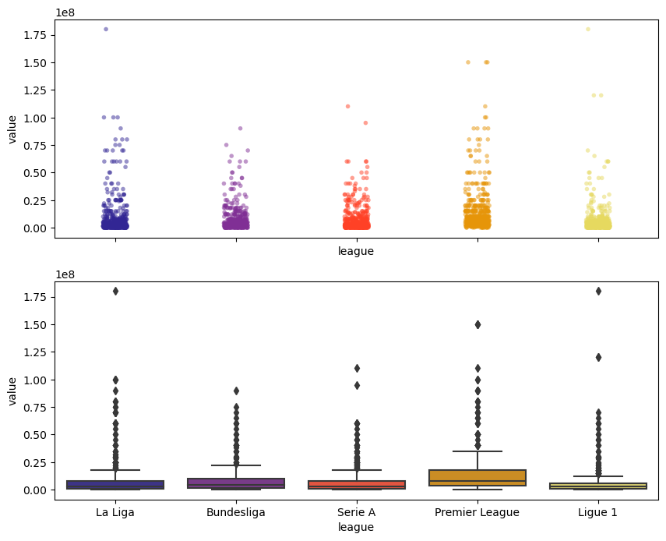
Scatter & Box Plot – Value vs. League

Slide 7
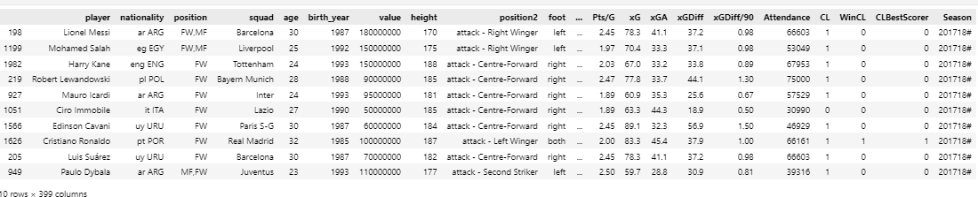
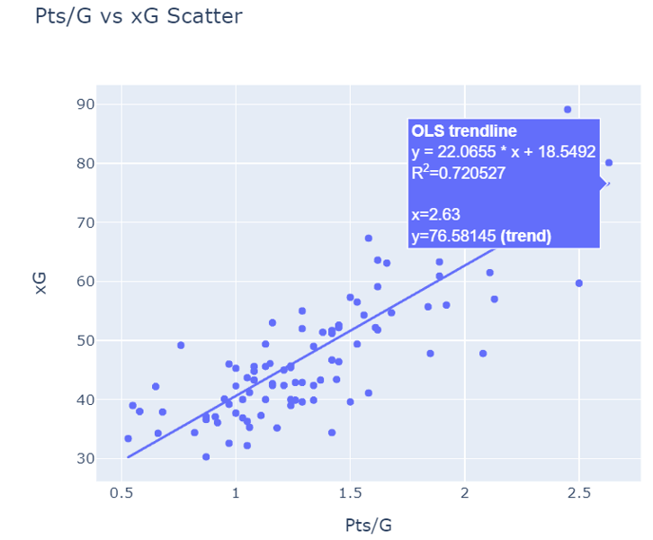
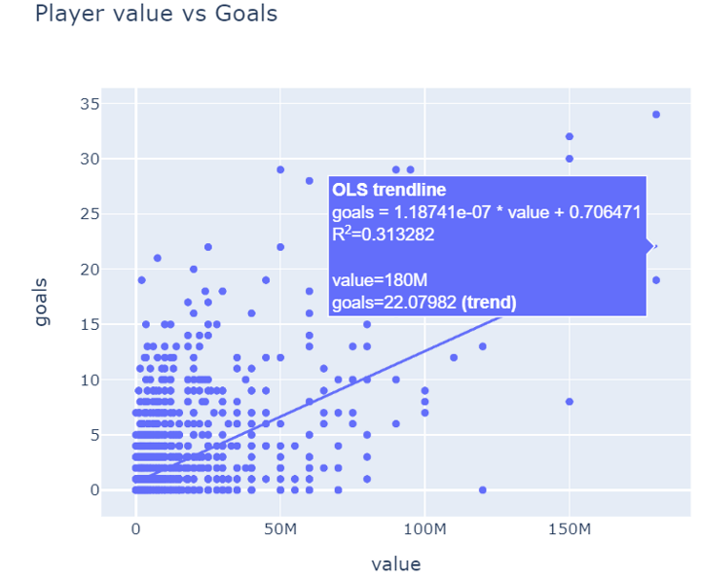
Player Goal Statistics
t-statistic: 177.92156247083068 p-value: 0.0
t-statistic: 27.163586450073577
p-value: 1.6921283697150687e-150
Notes:
Highlight the importance or value of the parameters used to identify top 10 players. For example if to put value of the player in the first place the table will show one list of players, if to put number of goals then list will be different

Slide 8
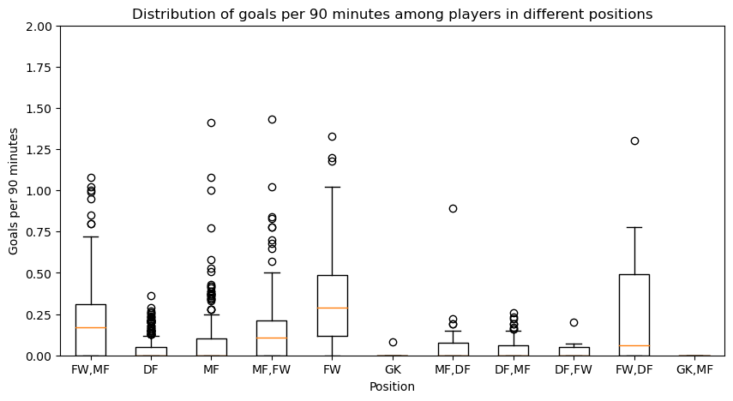
Goal distribution per Player Position

Slide 9
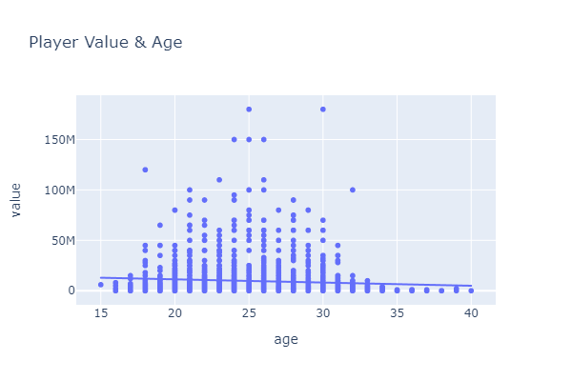
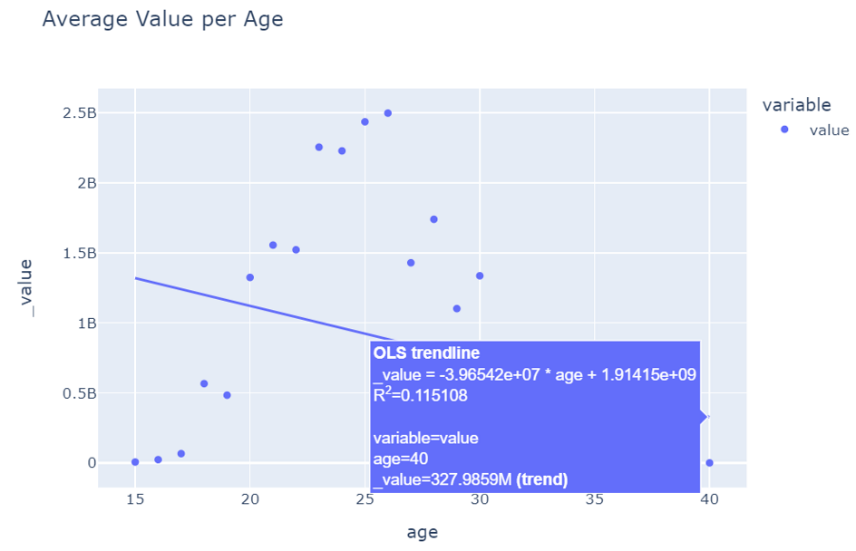
Player Value & Age
Replace with your own text

Slide 10
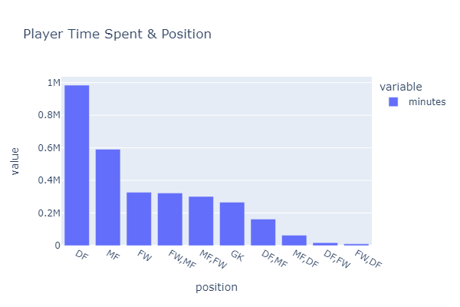
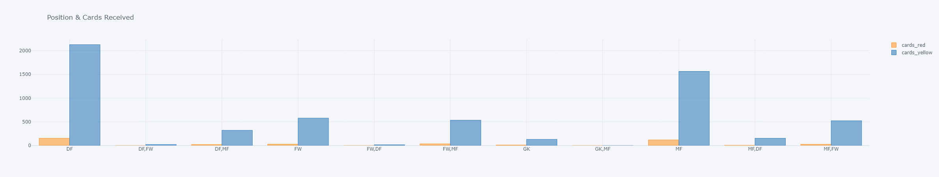
Player Position & Cards Received

Slide 11
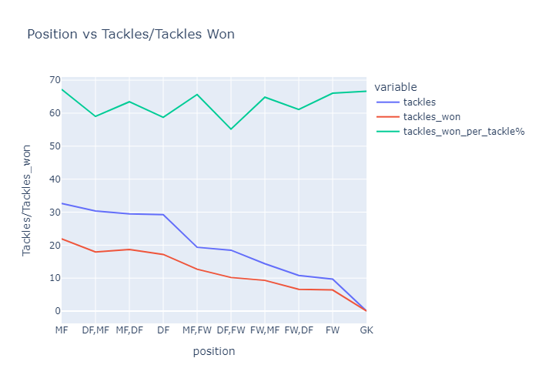
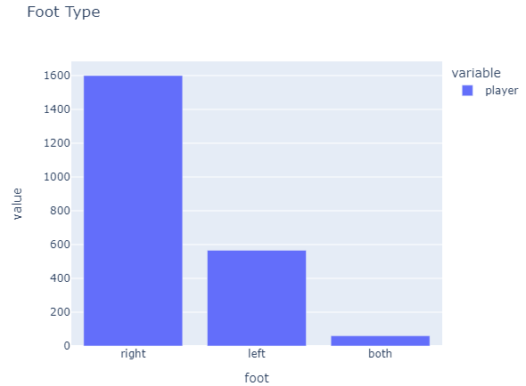
Tackles vs. Tackles Won

Slide 12
Analysis & Conclusions
Write up summaries, major findings, and implications.
Each question answered precisely with ample info
Findings strongly support #s & viz
Each question supported with statistical analysis (aggregation, correlation, comparison, summary stats, sentiment analysis, time series analysis, liner regression, etc.)

Slide 13
THANK YOU!

